Slide 1

Implementation and Performance of Fraud Detection Model

Slide 2
Overview
Problem: Increasing cases of fraud leading to customer dissatisfaction.
Solution: Implemented a machine learning model to identify and flag potential fraudulent transactions.
Model: RandomForest Classifier, chosen for its ability to handle a mix of categorical and numerical data and its high performance in binary classification tasks.
Method: Oversampling of minority class (fraudulent transactions) using SMOTE to handle the imbalanced dataset. The model was then trained and tested with 80/20 split.
Performance: High ROC AUC score of 0.97 indicating a very good performance.

Slide 3
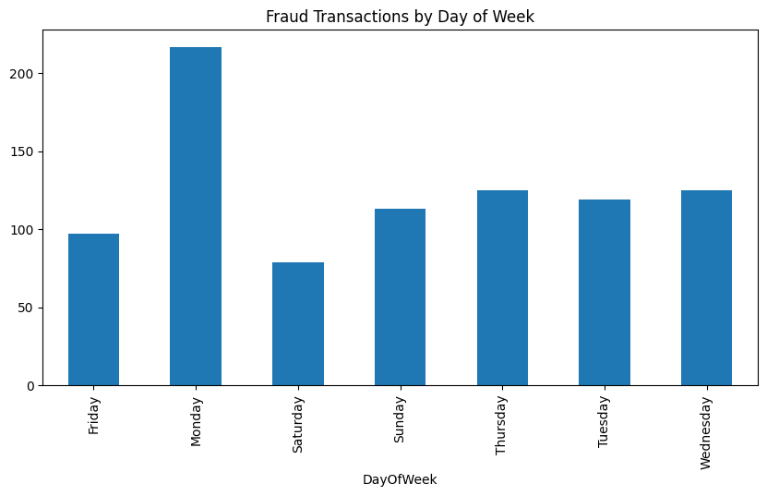
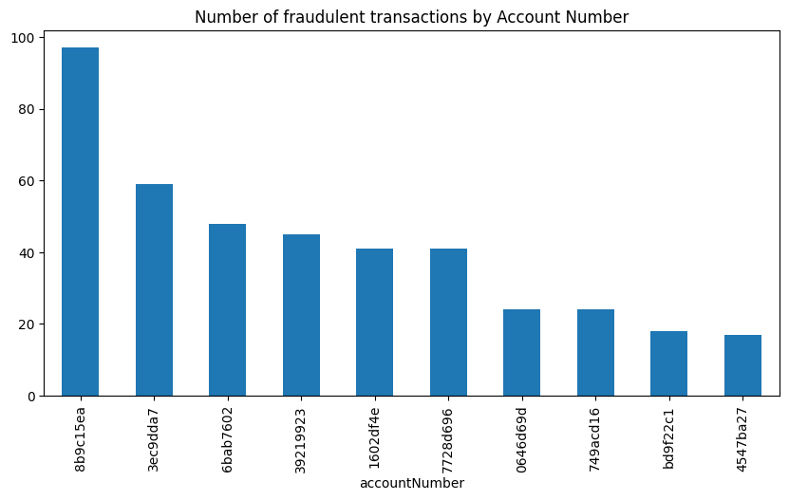
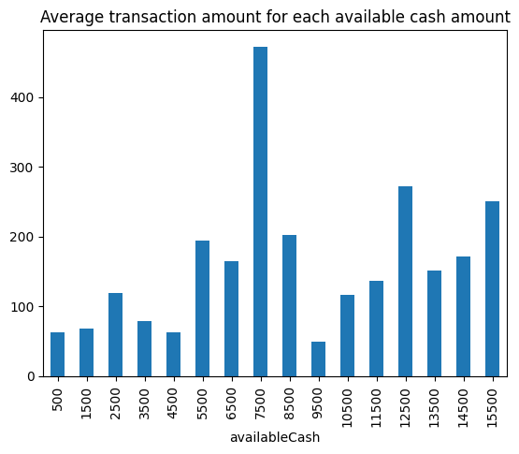
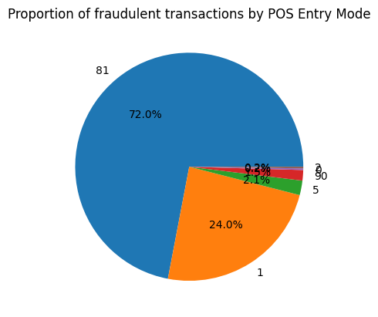
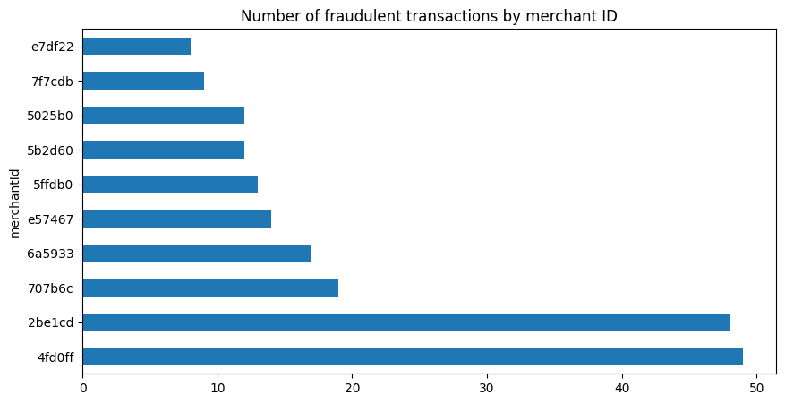

Slide 4
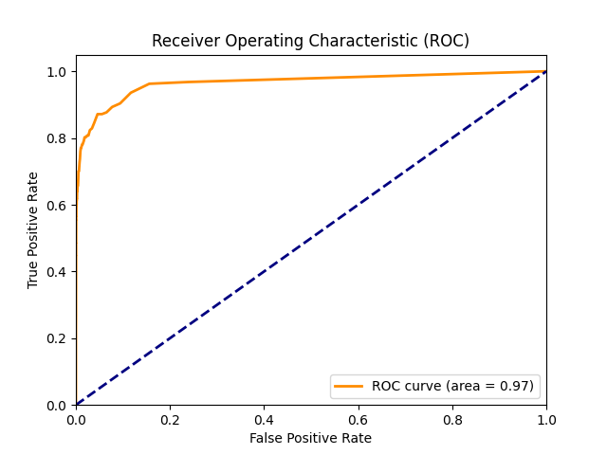
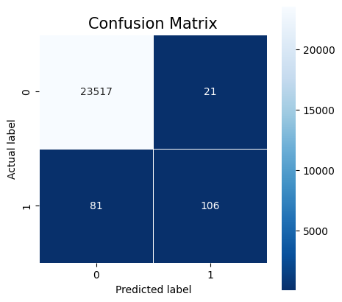
Model Performance

Slide 5
Impact
Efficiency: With our model, the bank's team of fraud analysts can focus on the top 400 risky transactions per month, improving their efficiency.
Customer Satisfaction: By preventing fraudulent transactions, we improve customer satisfaction and trust in the bank.
Preventive Measures: Insights from the data showed that certain days of the week, hours of the day, certain merchants, and point-of-sale (POS) entry modes are more prone to fraud. This information can be used to implement preventive measures.
Savings: By preventing fraudulent transactions, the bank can save a significant amount of money which can be calculated once we have real monetary values associated with the frauds.
Future Improvements: The model's performance can further be improved by feature engineering, trying out different oversampling techniques, and implementing deep learning algorithms.

